Slide 1


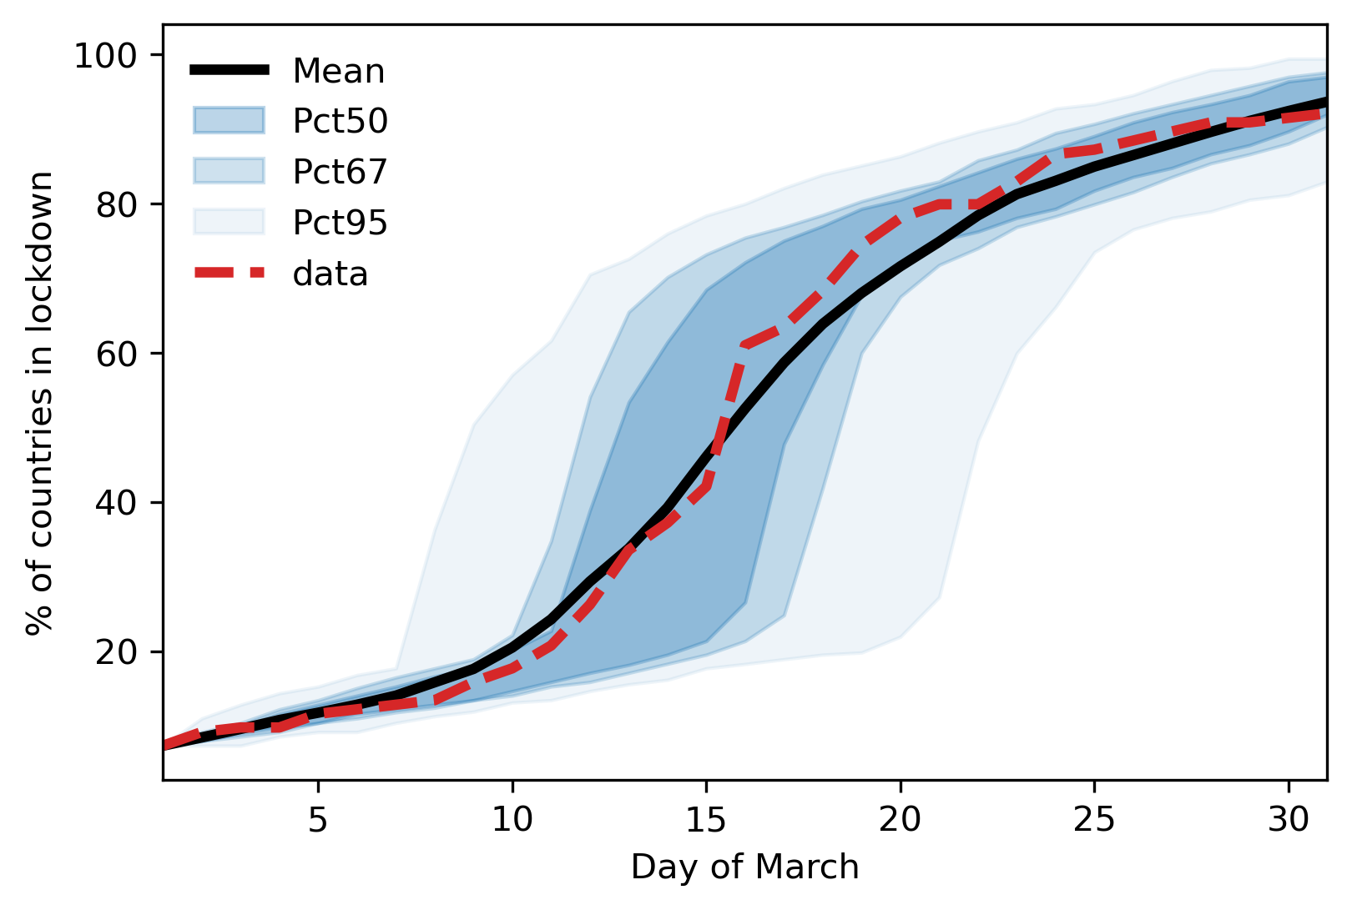
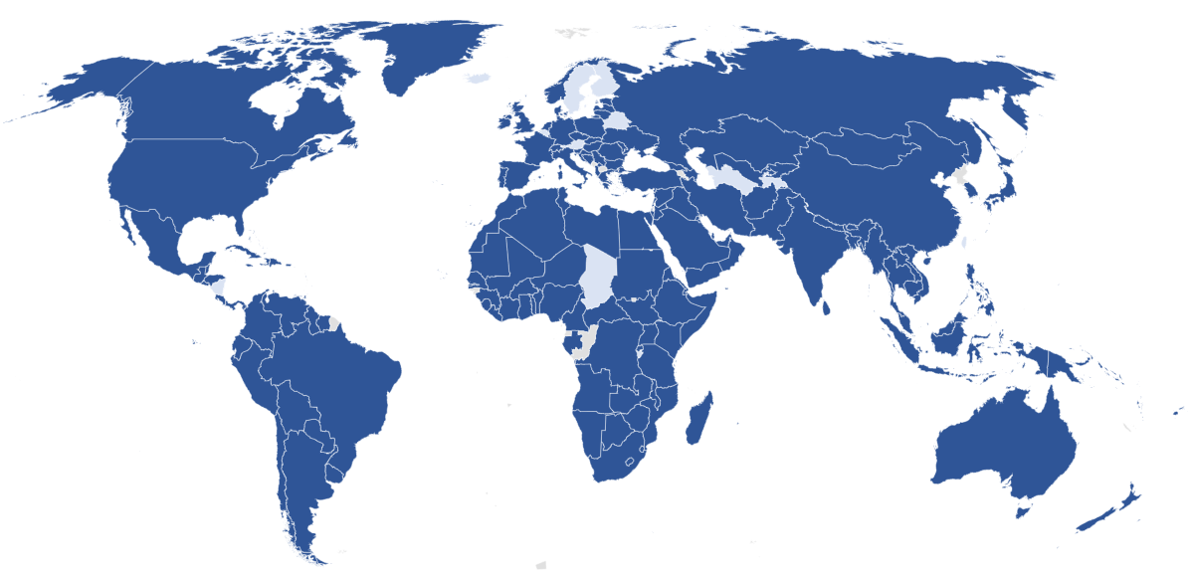

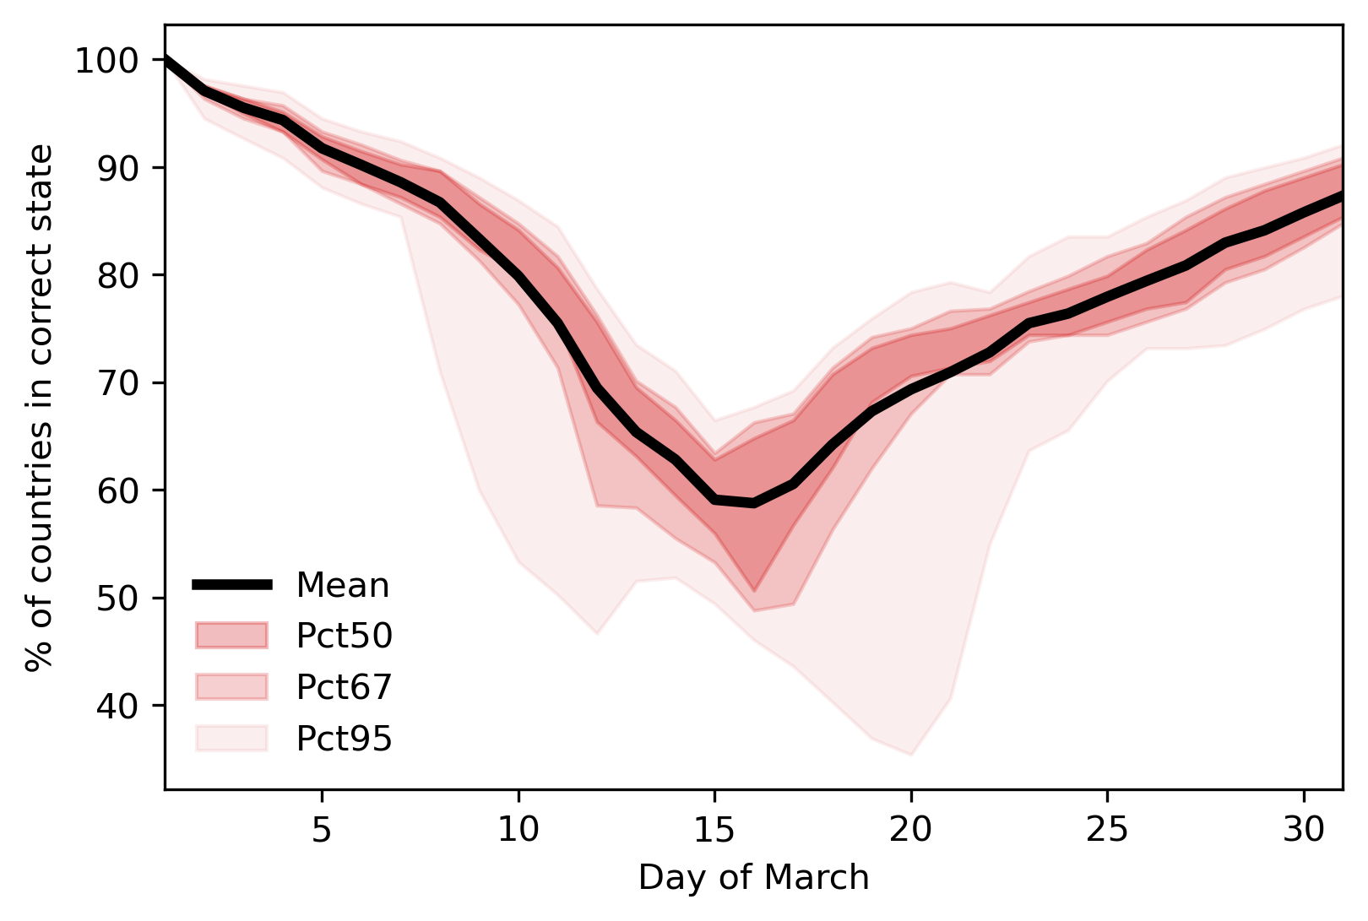
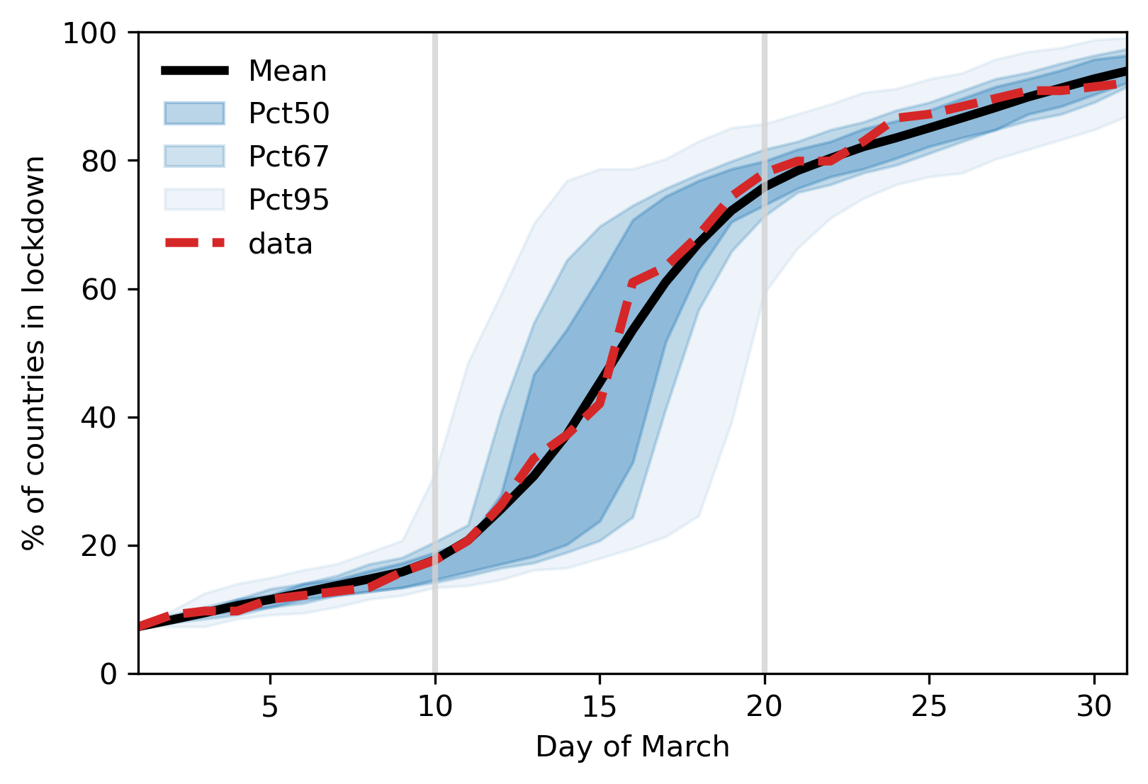
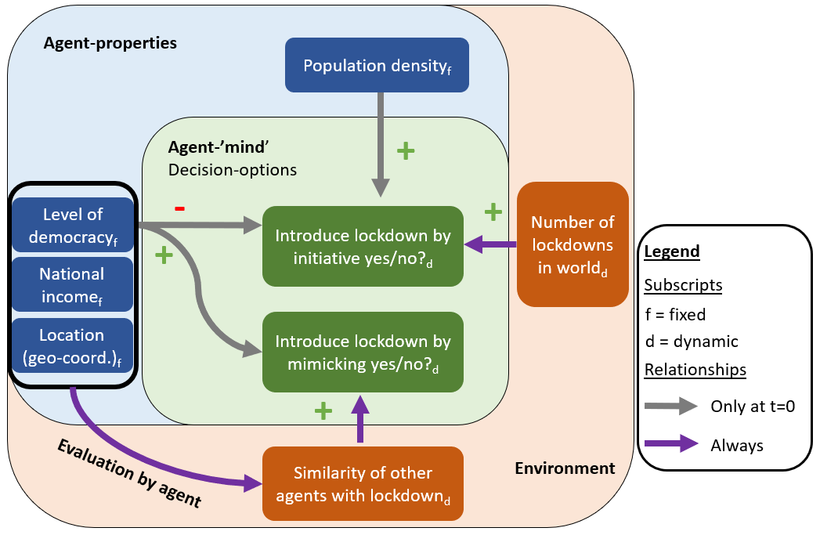
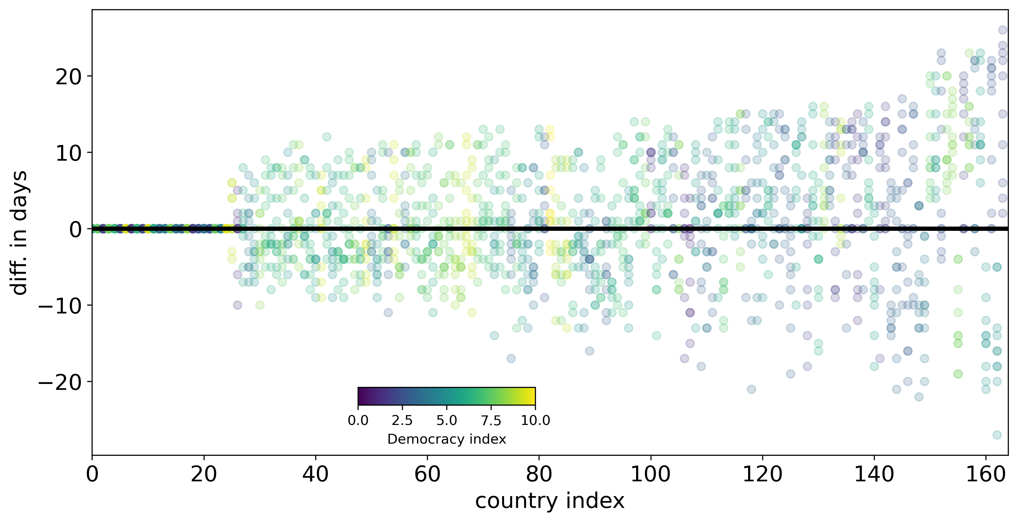
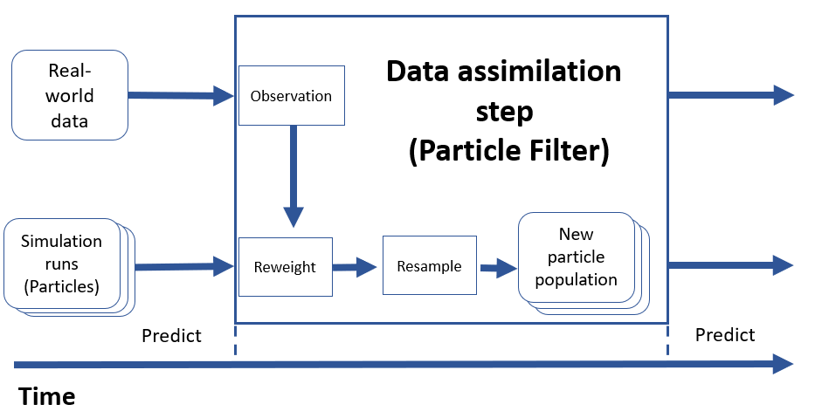
TOWARDS ANTICIPATING RAPID GLOBAL POLICY SHIFTS
An agent-based model of the 2020 tipping point in global covid policy response with integrated data assimilation
Twitter:
@yl_oswald
Yannick Oswald*, Nick Malleson School of Geography, University of Leeds
An entire world in lockdown.. How?
Results: From Macro to Micro!
Solutions to the climate crisis require global policy tipping points. But they never seem to happen. In spring 2020, during the first global wave of the COVID-19 pandemic, such a rapid policy tipping point was observed….
Model base run
N = 100
Calibrated to data
Result Figure 1:
MACRO ACCURACY
We can relatively well predict the aggregate diffusion curve, or, in other words, the total number of countries in Lockdown. But the variance is high.
31st March 2020
High variance
Exponential virus spread.
But is that enough?
Result Figure 2:
MICRO ACCURACY
We struggle with predicting accurately which specific countries are in lockdown when exactly, especially during the critical transition phase!
Full lockdown
Accuracy decreases
No lockdown
Hypothesis: Countries acted like individual people. They mimicked ‘peers’.
Objective: Reproducing lockdown adoption pattern without knowledge about virus spread.
No-maths model description
The principal idea of the model is that the adoption of lockdowns across countries can be described independently of the actual COVID-case numbers across countries. The main mechanism is that the agents/countries mimic other countries that have adopted a lockdown and are similar to themselves.
(Pseudo-)Particle Filter and individual countries
N = 100
Calibrated to data
Result Figure 3:
A Particle Filter does reduce variance of model results and hence the reliability.
Data
Assim.
Result Figure 4:
This Figure illustrates over 10 simulation runs whether individual countries have been accurately predicted.
Less variance
Too late
Increasing inaccuracy
Too early
Real-time observations to make better prediction
What’s next?
Make model better, discuss with political scientists
Study whether generalizable to climate crisis
Private jet ban?
Carbon taxes, green subsidies etc.?
Activists are right to increase ‘alarm’
(Justified) fear of the pandemic
induced the mimicking behaviour
Climate-economic ABMs with data assimilation
Data
Your ideas?
+
Theory
=
Optimal

